Slide 1


STUDYING THE INTEGRITY OF SNF ROD CLADDING AT VARIOUS STAGES OF DRY STORAGE TECHNOLOGY IMPLEMENTATION
The National Academy of Sciences of Ukraine
National Science Center "Kharkov Institute of Physics and Technology"
"Nuclear Fuel Cycle" Science and Technology Establishment
Valeriy Zuyok, Mykhaylo Tretyakov, Roman Rud, Vоlodymyr Zigunov,
Yana Kushtym, Vadym Hrudnytskyy
E-mail of the Corresponding Author: valeriyz@kipt.kharkov.ua
1st INTERNATIONAL CONFERENCE ON LWR FUEL PERFORMANCE, MODELLING AND EXPERIMENTAL SUPPORT
14-19 September 2025, Sol Nessebar Resort, Nessebar, Bulgaria

Slide 2
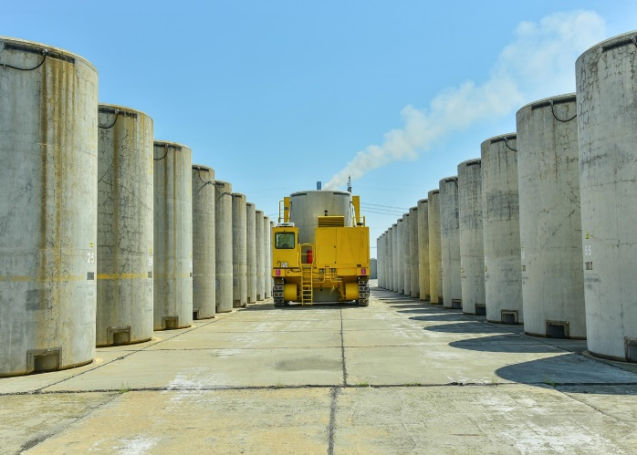
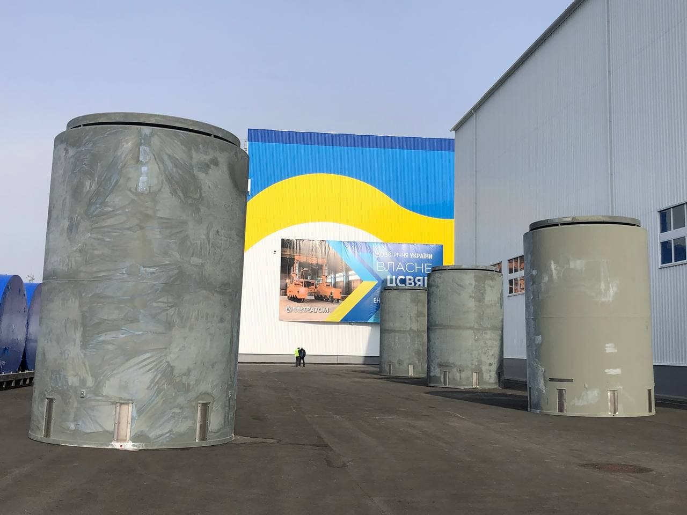
Spent nuclear fuel storage in Ukraine
The Concept of Spent Nuclear Fuel (SNF) Management in Ukraine was approved by a resolution of the Cabinet of Ministers of Ukraine and includes long-term interim storage of SNF at two open sites in sealed steel canisters placed in concrete containers:
Dry spent fuel storage facility (DSFSF) at the ZNPP site – storage of SNF for 50 years with the possibility of extending the term to 100 years;
The Consolidated (Centralized) Spent Fuel Storage Facility (CSFSF) in the Chernobyl Exclusion Zone – storage of spent nuclear fuel for up to 100 years.
DSFSF (ZNPP) | CSFSF (Exclusion zone)

Slide 3
Requirements for maintaining the integrity of fuel rod claddings throughout the storage period
The DSFSF system at the Zaporizhzhya NPP is designed to store leak-proof spent FAs, with the fuel rod claddings being the first protective barrier against the release of radioactive substances into the environment.
Throughout the entire period of long-term (50 years) dry storage, claddings must not degrade to the extent that more than one percent (1%) of fuel rods are damaged, which would result in their leakage.
There are requirements (criteria) set by fuel vendors to ensure the integrity of fuel rod claddings under storage conditions, which, if not exceeded, should guarantee the absence of damage. Among the general requirements for all fuel vendors (JSC TVEL, Westinghouse) are requirements for long-term storage temperature and short-term overheating temperature.
The acceptance criteria for cladding temperature (350 °C for normal storage conditions and 450 °C for emergency conditions and during transport and technological operations) are conservative in relation to similar Westinghouse criteria for WFA/RWFA and TVSA/M and can therefore be applied as acceptability criteria for the storage of WFAs/RWFAs and TVSAs/Ms in the ZNPP DSFSF.

Slide 4
Main factors contributing to the degradation of zirconium fuel rod claddings
JNES (Japan Nuclear Energy Safety Organization) [*] ranked the main technical aspects of long-term storage of SNF and factors that may affect the integrity of fuel rod cladding during dry storage:
thermal creep;
hydrogen effects in zirconium cladding (hydrogen accumulation, hydride formation, hydride reorientation, hydrogen migration under temperature gradients);
recovery (high-temperature annealing) from radiation damage;
stress corrosion cracking;
cladding corrosion;
and others.
No fuel inspections were performed during storage in dry storage facilities in Ukraine.
The fuel performance under dry storage conditions is justified by calculation methods, taking into account the results of laboratory simulation tests.
*. T. Saegusa1, K. Shirai, T. Arai, J. Tani, H. Takeda, M. Wataru, A. Sasahara та P. L. Winston, Review and Future Issues on Spent Nuclear Fuel Storage // Nuclear Engineering and Technology, 2010, vol. 42 , № 3 June, p. 237 – 248.

Slide 5

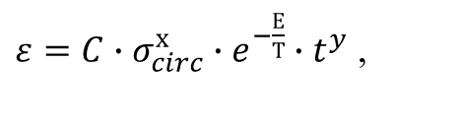
Temporary storage of SNF in fuel storage pool
After unloading the SNF from the reactor core, they are temporarily stored in the fuel storage pool (FSP) to reduce energy release to an acceptable level (0.99 kWt for ZNPP DSFSF).
Typical fuel storage conditions in FSP are as follows: low fuel rod cladding temperature (50–75°C), controlled water chemistry, and absence of dense fast neutron flux.
The rate of most processes exhibits an exponential function of the cladding temperature, for example:
$ε=C∙σ_{circ}^{х}∙e^{−\frac{Е}{Т}}∙t^{y}$ ,
$\frac{∆m}{S}=А∙{e^{\frac{−Q}{RT}}∙t}^{n}$,
ε – circumferential deformation, %
– corrosion related mass change per unit area, mg/dm²
The results of computational and analytical studies have revealed that under temporary storage conditions in FSP, the characteristics of fuel rods remain almost at the same level as they were after unloading from the reactor core. This is due to the low temperature of the cooling water, the absence of fast neutron dense flux, and the controlled water chemistry in FSP.

Slide 6
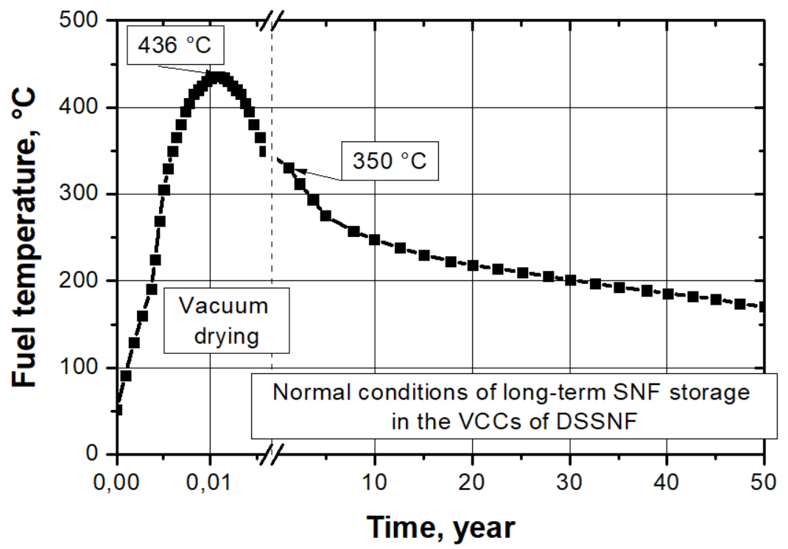
Change in fuel rod cladding temperature
During the implementation of dry storage technology for spent fuel at the ZNPP dry storage, the following stages are considered separately:
- vacuum drying;
- filling the canister with helium and reaching a stationary mode for long-term storage;
- storage under normal conditions (initial 350 °C, 50 years);
- storage under off-normal conditions (+11 °С);
- under accidets (+19 °С);
- loss of canister integrity at the vacuum drying stage;
- cooling of a leaky canister;
- reloading of fuel (repeated vacuum drying);
- repeated long-term storage (50 years), etc.
Change in cladding temperature during vacuum drying followed by filling the basket with helium until reaching a stationary mode at a temperature of 350 °C

Slide 7
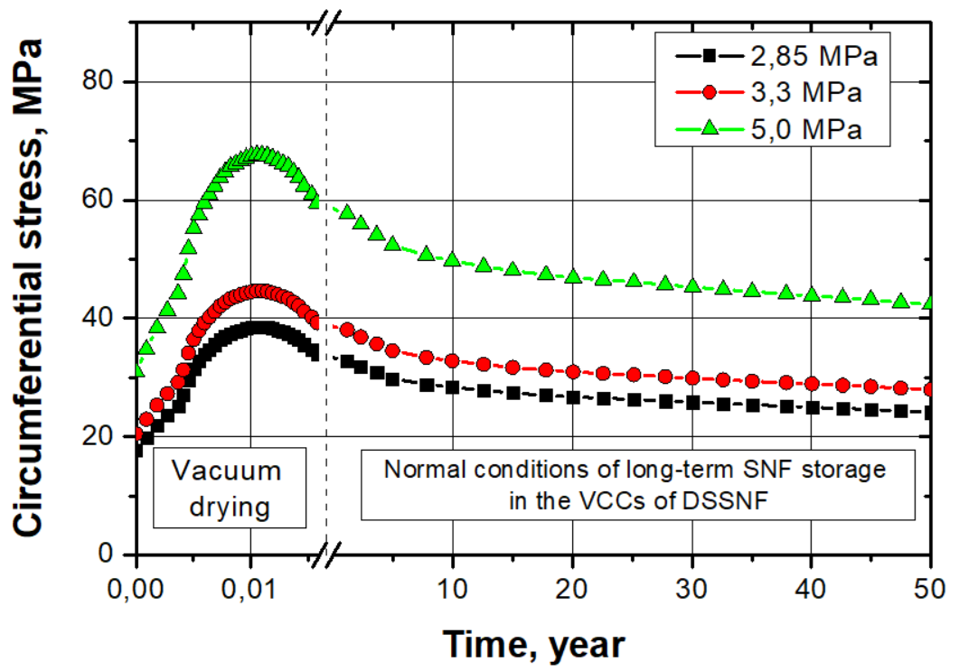
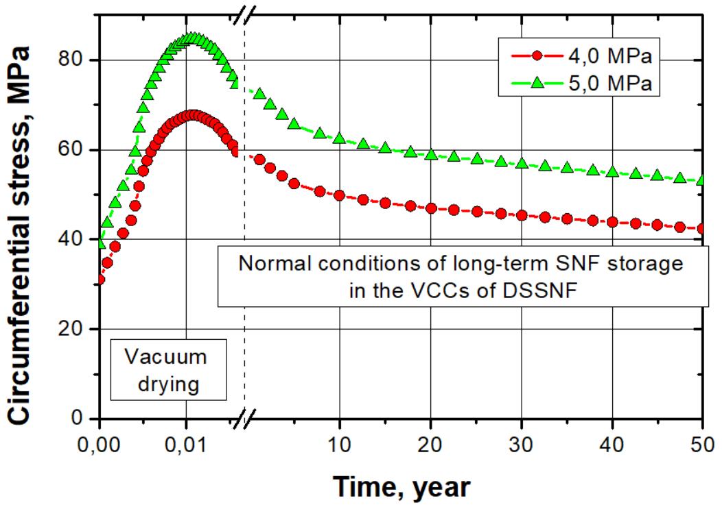
Stresses in fuel rod claddings
The maximum circumferential stress in cladding is typical for rods with high initial pressure of gaseous fission products (5.0 MPa) at vacuum drying temperature (436 °C).
The maximum circumferential stress for E110 alloy cladding is 67.7 MPa, and for ZIRLO alloy cladding is
84.7 MPa, which does not exceed the strength limit of the cladding material after operation (irradiation) in the core, taking into account the level of cladding degradation and the temperature effect.
Е110 | ZIRLO
Change in the cladding circumferential stress during vacuum drying followed by filling the basket with helium until reaching a stationary mode at a temperature of 350 °C and under long-term storage in ventilated concrete containers at the ZNPP dry storage site under normal conditions

Slide 8
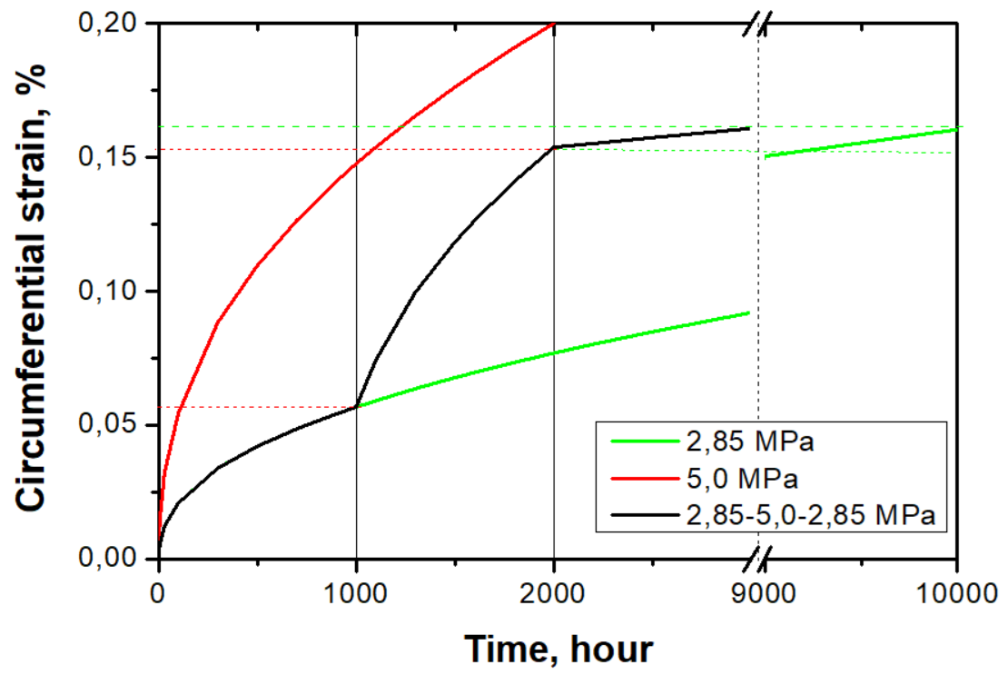
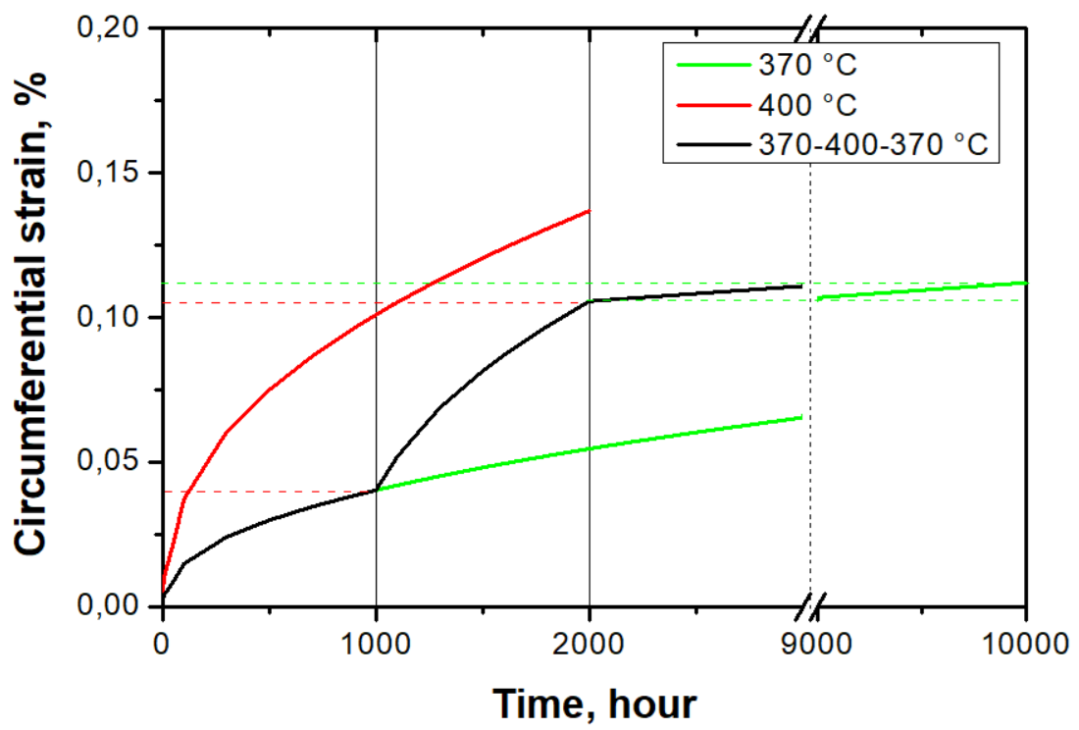
Functional dependencies
for calculating circumferential deformation
The creep rate is a function of the thermal exposure time at a constant test temperature and constant pressure of the gaseous fission products (GFP) under a cladding.
An increase in temperature or pressure initially results in a high creep rate, which slows down over time.
The developed sequence of dependencies correctly responds to stepwise changes in GFP pressure and stepwise changes in test temperature.
a | b
Circumferential deformation as a function of thermal exposure time at constant temperature and different GFP pressures (a) and at constant GFP pressure and different temperatures (b)

Slide 9
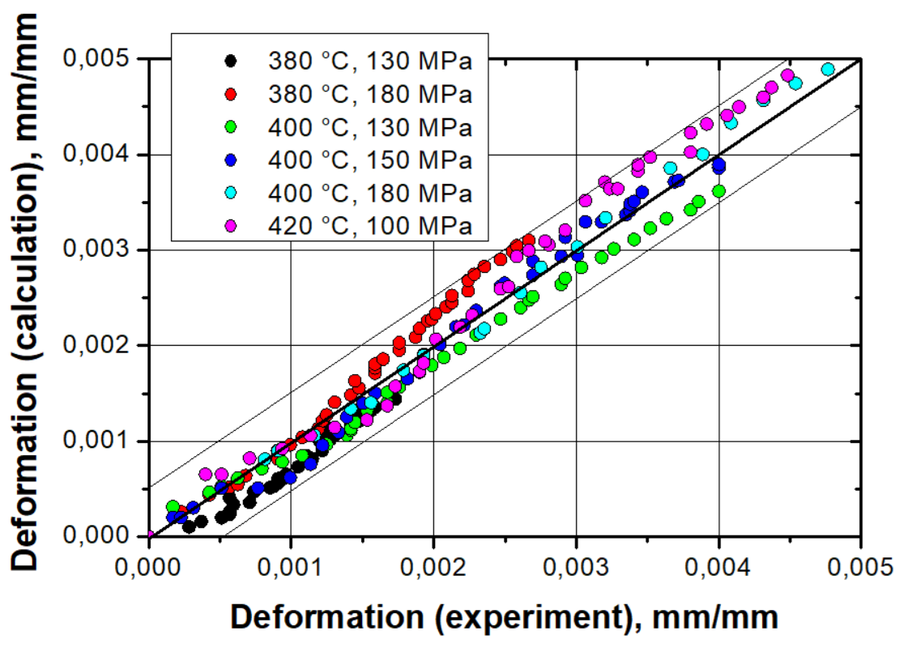
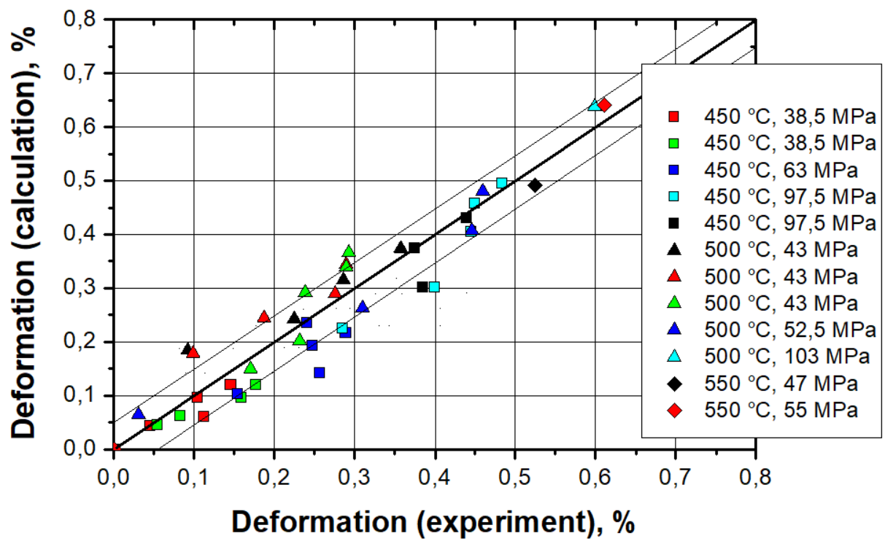
Functional dependencies
for calculating circumferential deformation
The developed expressions enable the calculation of circumferential deformation of irradiated fuel rod claddings made of E110 and ZIRLO alloys as a function of temperature, stress, and test duration with sufficient accuracy (the absolute difference between experimental and calculated data is ±0.05%).
Е110 | ZIRLO
Comparison of circumferential deformation obtained experimentally [1, 2] and by means of the developed dependence
1. А.Я.Рогозянов, Г.П.Кобылянский, А.Е.Новосёлов, А.А.Нуждов, И.М.Кадарметов, А.В.Медведев. Исследования анизотропной термической и радиационно-термической ползучести оболочечных труб из сплава Zr-1%Nb. ВАНТ. 2001. №2. № 79, с. 96-103.
2. Björn Andersson, Clara Anghel, Magnus Jinnestrand. Dry Storage of Spent Nuclear Fuel. Westinghouse Sweden, Vasteras, Sweden. Report Number: INIS-BG--2730. 13. International conference on WWER fuel performance, modelling and experimental support, 2020, p. 426-433

Slide 10
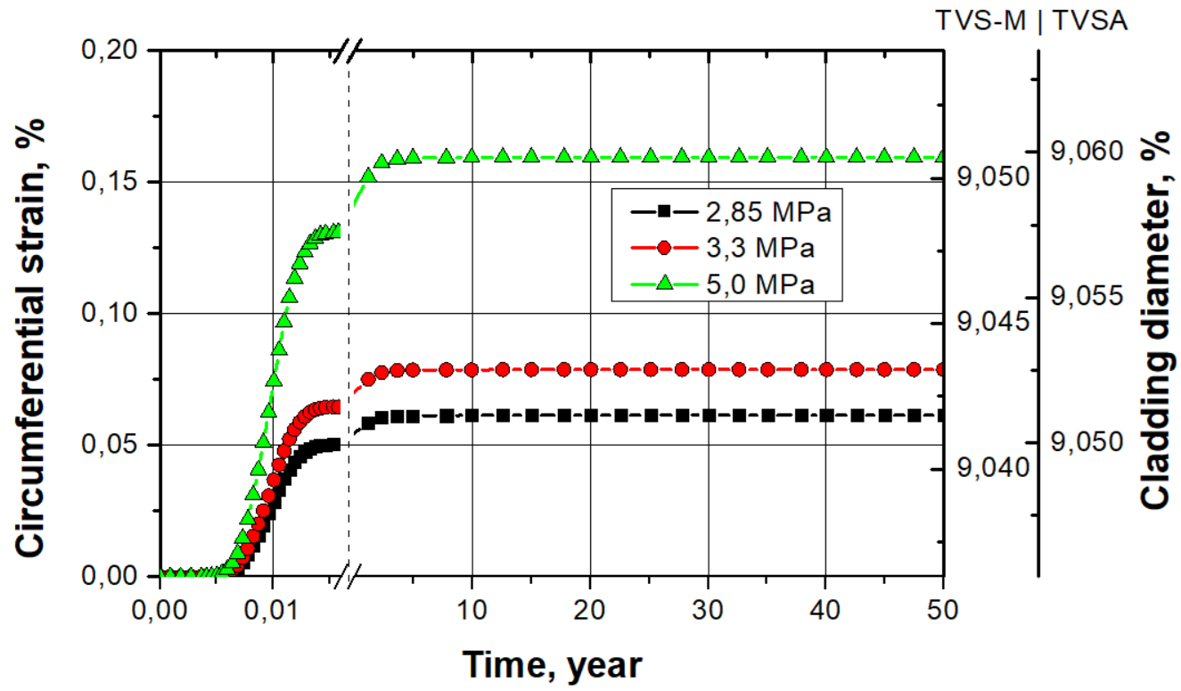
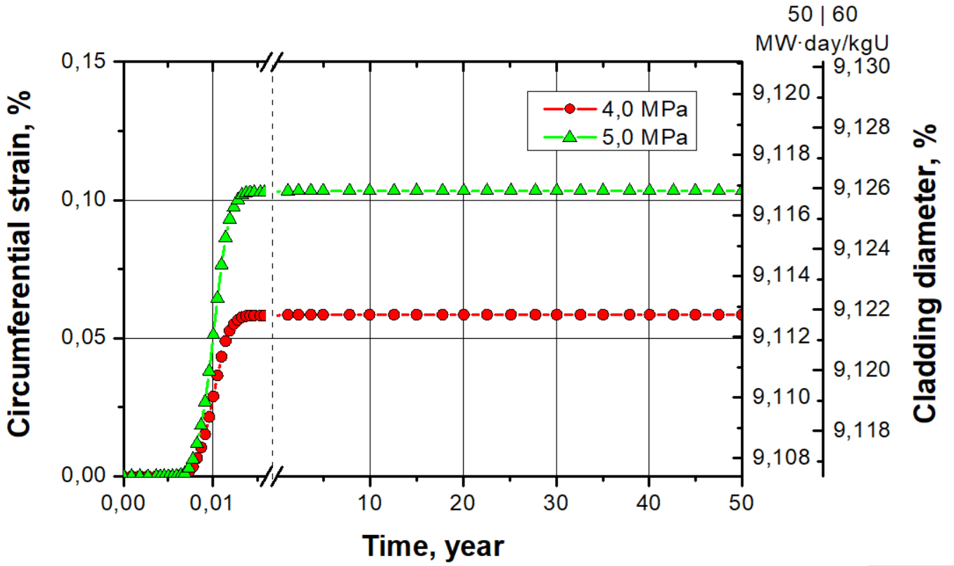
Deformation of fuel rod claddings
Irreversible deformation resulting from thermal creep progresses rapidly during vacuum drying (E110, ZIRLO) and during the first 3-4 years of storage under normal conditions (E110). Deformation depends on the GFP pressure and is higher for fuel rods with higher GFP pressure under cladding.
Even at extremely high GFP release under cladding (5.0 MPa), at the end of the 50-year storage period, the maximum circumferential deformation of cladding will be up to 0.159% for E110 and 0.103% for ZIRLO, which does not exceed the design criterion for maintaining the integrity of fuel rod claddings (2% for TVS-M, TVSA and 1% for RWFA).
Е110 | ZIRLO
Irreversible deformation of fuel rod claddings during vacuum drying and long-term storage under normal conditions

Slide 11
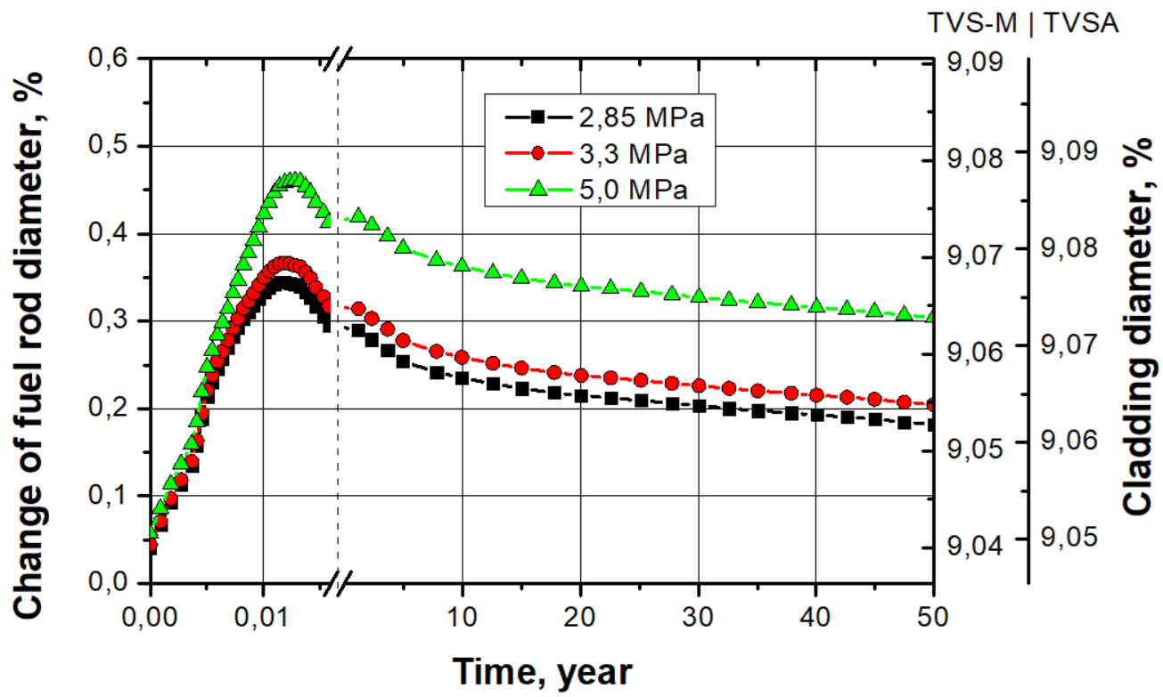
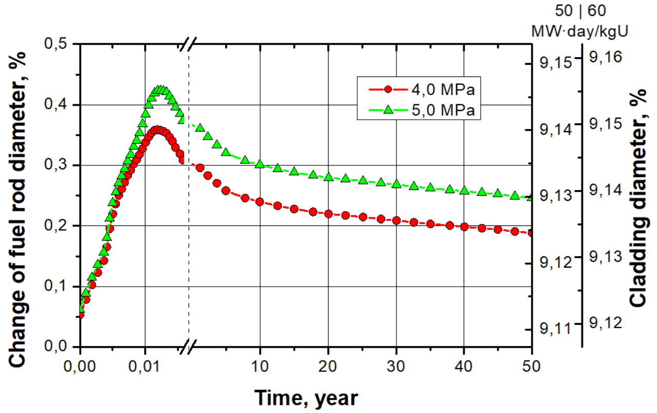
Change in fuel rod cladding diameter
The total change in cladding diameter, including both irreversible and reversible deformations, is the highest for claddings with the maximum initial GFP pressure (5.0 MPa) during vacuum drying at a maximum temperature (436 °C) and is 0.460% and 0.423% for E110 and ZIRLO alloy claddings, respectively.
Under long-term storage conditions, the total change in cladding diameter decreases and, at the end of the design storage life under normal conditions, will be 0.304% and 0.246% for E110 and ZIRLO alloy claddings, respectively.
Е110 | ZIRLO
Change in cladding diameter during vacuum drying and long-term storage under normal conditions

Slide 12
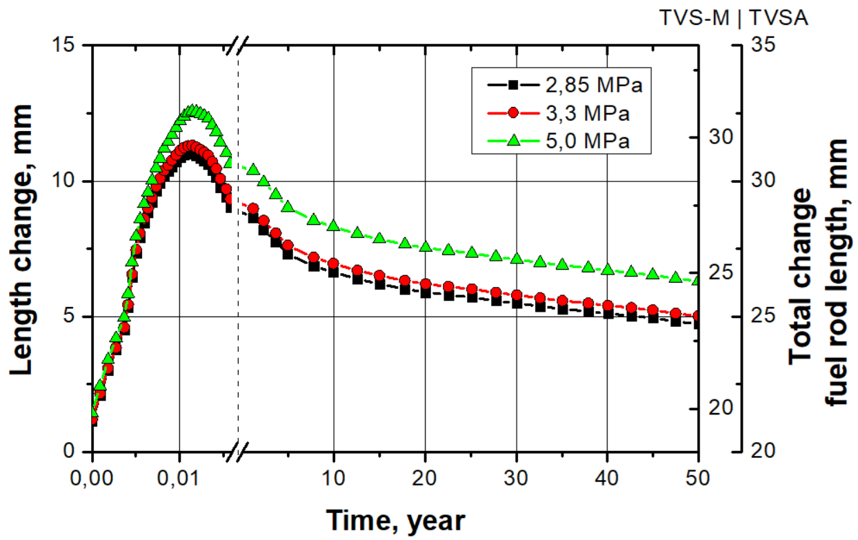
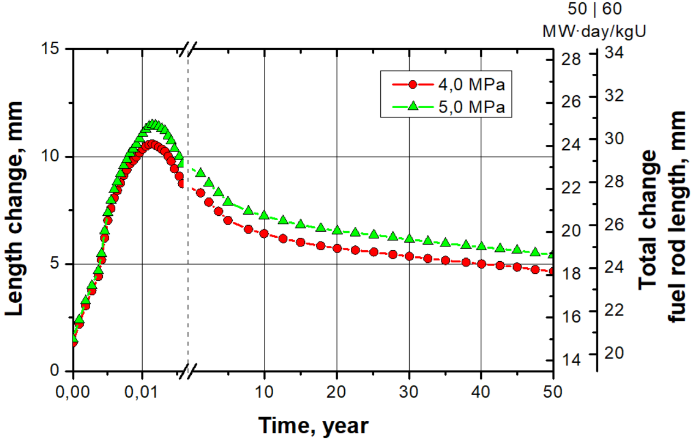
Change in fuel rod length
Thermal effect on cladding can result in increased creep (contrary to the known creep model for gas-filled tubular fuel rod imitators), which increases the length of fuel rod.
The maximum calculated rod elongation corresponds to the stage of vacuum drying of claddings with the maximum initial GFP pressure (5.0 MPa) and is 12.6 mm and 11.5 mm for E110 and ZIRLO alloy claddings, respectively.
The elongation of fuel rods is less than the axial gap, even at room temperature (18.6 mm for TVS-M, 44 mm for TVSA, and 26.3 mm for RWFA) and does not result in fuel rod contact with top or bottom nozzles.
Е110 | ZIRLO
Fuel rod length change during vacuum drying and long-term storage under normal conditions

Slide 13
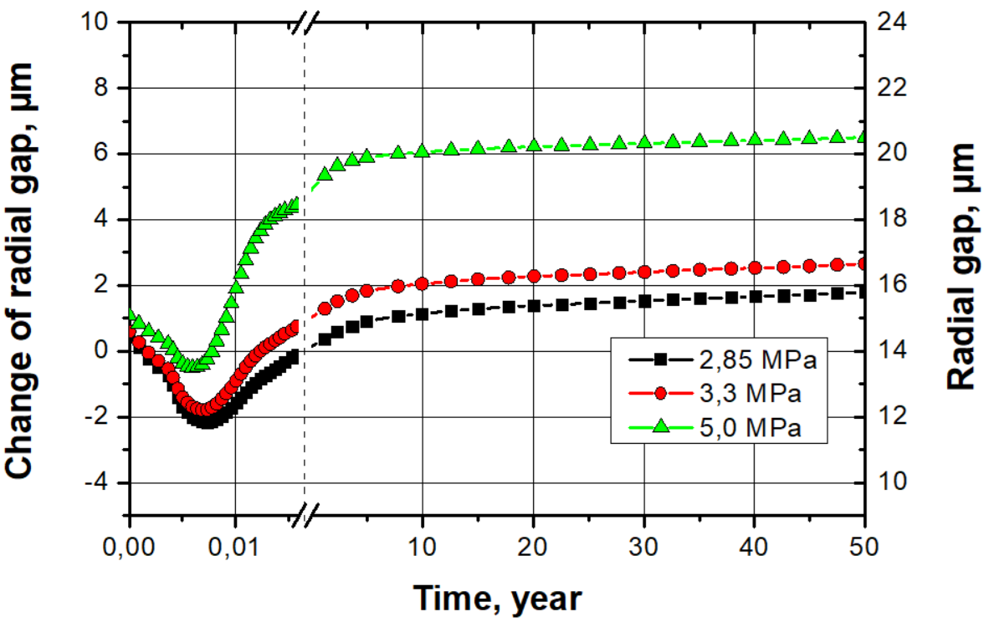
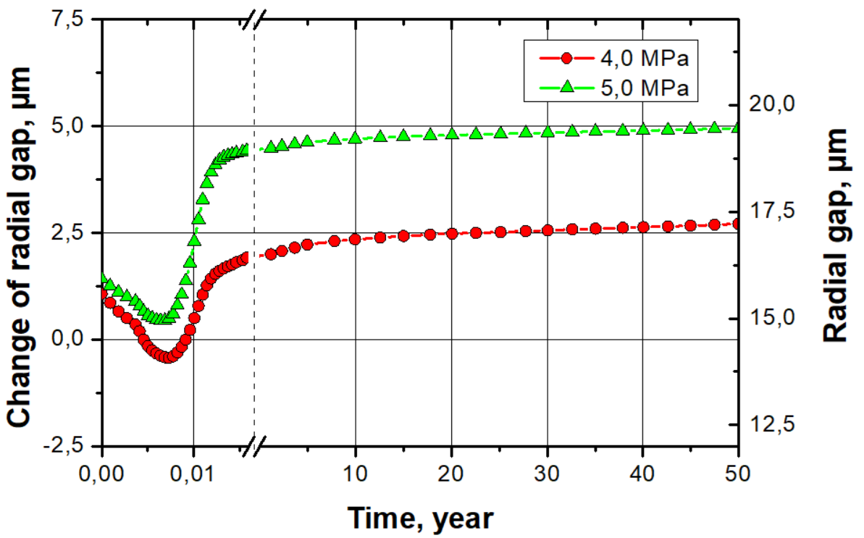
Fuel pellet-cladding gap
The maximum reduction in the fuel pellet-cladding gap is typical for claddings with a lower initial GFP pressure.
For E110 alloy claddings with an initial GFP pressure of 2.85 MPa (TVS-M), it is -2.2 μm, and for ZIRLO alloy claddings with an initial GFP pressure of 4.0 MPa, it is -0.4 μm.
Increasing the storage time will only increase the gap between pellets and cladding, preventing close contact. Thus, the justification for retaining cladding integrity does not require taking into account additional circumferential and longitudinal stresses in cladding that affect changes in creep rate, hydrides reorientation, etc.
Е110 | ZIRLO
Change in fuel pellet-cladding radial gap during vacuum drying and long-term storage under normal conditions

Slide 14
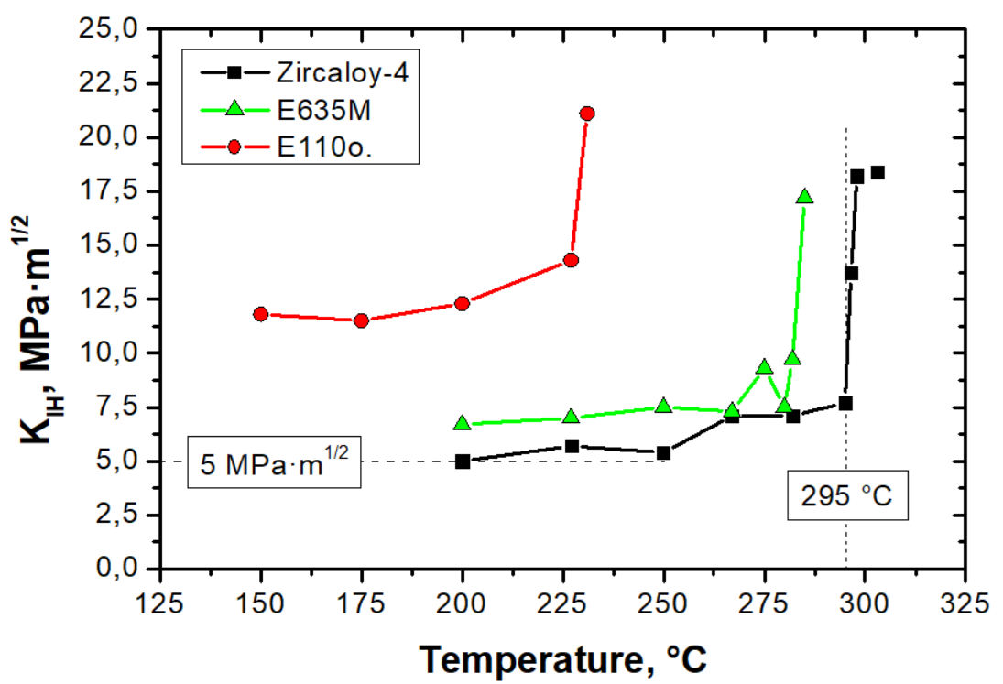
Assessment of delayed hydride cracking occurrence possibility
The main parameter that is responsible for the DHC initiation is the critical stress intensity factor (K_{IH}) at the crack apex. A crack begins growing when this critical value is reached.
For further calculations and assessment of the possibility, it can be conservatively assumed that reaching
K_{IH} = 5,0 MPa·m^{1/2} will result in the DHC initiation.
Stresses in fuel rod claddings can be caused by the mechanical interaction of fuel pellets and a cladding, the GFP pressure under a cladding, and residual stresses in weld joints.
The formation of stresses in fuel rod claddings, which can cause the phenomenon of DCH due to mechanical contact between fuel pellets and a cladding, can be excluded.
Critical stress intensity factor (K_{IH}) as a function of temperature for three alloys [*]
* N. S. Saburov, V. A. Markelov, and V. V. Novikov, “Delayed Hydride Cracking of Fuel Rod Claddings Made of Three Zirconium Alloys,” in Zirconium in the Nuclear Industry: 20th International Symposium, ed. S. K. Yagnik and M. Preuss (West Conshohocken, PA: ASTM International, 2023), 173–195

Slide 15
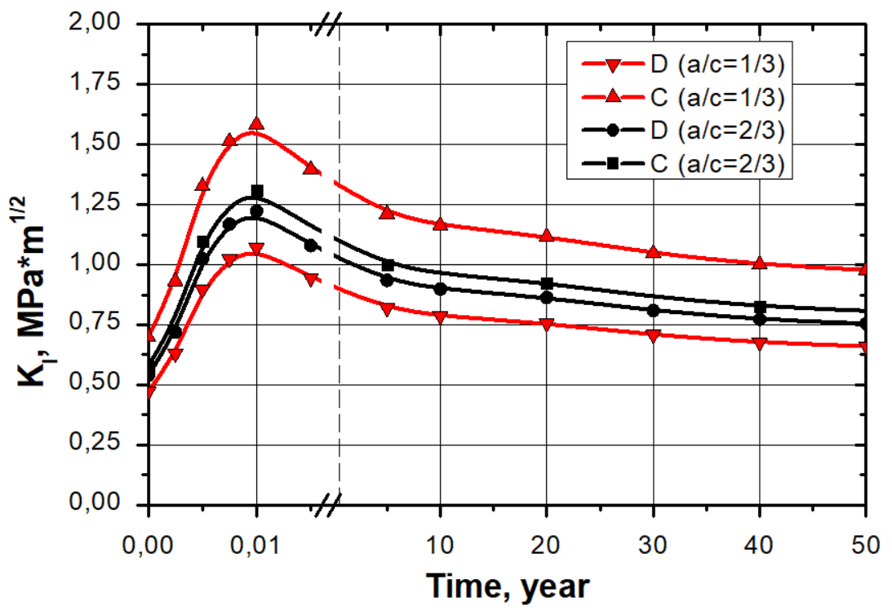
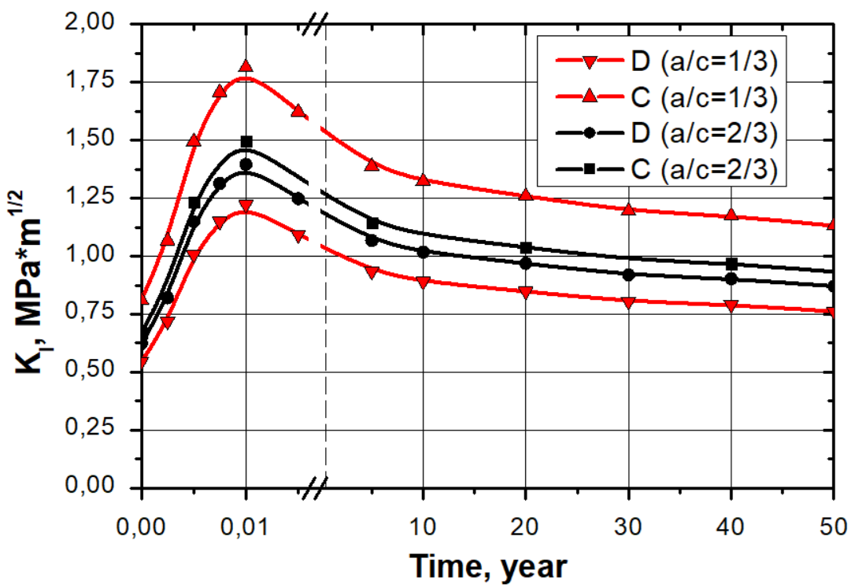
Assessment of delayed hydride cracking occurrence possibility
The performed set of calculations enabled to conclude that for a conservative crack with a depth of 0.25 of the cladding thickness, under temperature modes typical for SNF in ventilated concrete containers (VCCs) at the ZNPP dry storage site, DHC will not occur due to internal pressure on the cladding (GFP, pellets), since the maximum calculated value of K_{I} for rods with E110 and ZIRLO alloy claddings does not exceed the conservative critical value of K_{IH} = 5.0 MPa·m^{1/2}.
Е110 | ZIRLO
Dependence of K_{I} on time during thermal impact at the stage of vacuum drying with subsequent filling of Multi-Purpose Canister (MPC) with helium until reaching the stationary mode at 350 °C and during long-term storage of SNF in VCCs under normal conditions at the ZNPP dry storage site

Slide 16
Summary table of calculation results
Parameter Cladding material | Limit values | Calculated values
 |  | Drying | Storage (50 years)
Circumferential stress
Е110 | < ~160 MPa | 67.6 | 57.6
ZIRLO | < ~300 MPa | 84.6 | 74.4
Circumferential deformation
Е110 | < 2 % | 0.13 | 0.16
ZIRLO | < 1 % | 0.10 | 0.10
Diameter
Е110 | < ~9.10 | 9.08 | 9.07
ZIRLO | < ~9.144 | 9.144 | 9.129
Pellet-cladding gap change
Е110 | < 5 μm | -2.2 | +0.3
ZIRLO |  | -0.4 | +2.7
Fuel rod lenghth change
Е110 (TVS-M / TVSA) | < 18 / 44 mm | 12.6 | 6.3
ZIRLO | < 26.3 mm | 11.5 | 5.4
Delayed hydride cracking
Е110 | < 5.0 MPa·m^{1/2} | 1.58 | 0.97
ZIRLO |  | 1.81 | 1.13

Slide 17
Conclusion
Additional requirements have been proposed, the meeting of which helps to justify the retention of fuel rod claddings integrity during thermal effects, namely: retention of the fuel pellet-cladding gap; retention of the axial gap that prevents clamping of fuel rods; not exceeding the design diameter of the claddings; not exceeding the circumferential stresses in the claddings of the yield strength of the material; not exceeding the stress intensity factor in the vicinity of crack of a conservative value of 5.0 MPa·m^{1/2}. If it is not possible to meet the additional requirements, it is necessary to perform an additional assessment of the stress-strain state for fuel rod claddings taking into account additional tensile stresses.
The results of the predictive calculations revealed that during the implementation of the dry storage technology, the calculated/specified parameters of fuel rods with E110 and ZIRLO alloy claddings do not exceed the design criteria of fuel vendors (TVS-M, TVSA and RWFA) for cladding integrity and do not exceed additional requirements. This ensures the long-term (up to 50 years) storage of fuel produced by these vendors under normal conditions typical for the ZNPP dry storage facility.
The proposed calculation method, based on the results of laboratory simulation tests, can be applied to justify the integrity of fuel rod claddings for any other dry storage facility where fuel with E110 or ZIRLO alloy rod claddings is stored or is planned to be stored.

